Slide 1
Alberta’s Energy Utilities Regulatory System
Including the UCA’s role
within the system
June 2025

Slide 2
Table of Contents
Electricity System Responsibilities
Power Sector Framework in Alberta
Electricity Agencies’ Roles
Alberta Utilities Commission
How are Rates Determined

Slide 3
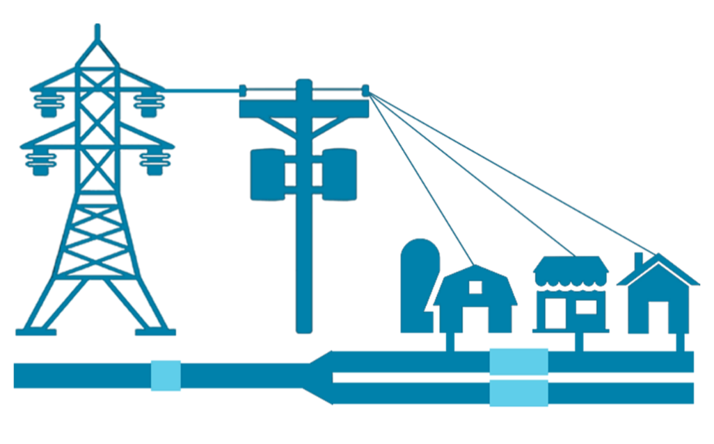
Regulatory Model for Energy Utilities
Regulated Monopoly Utilities
Generation & Production
Transmission
Distribution
Retailers
Consumers
Competitive
Market based
Private investment
Energy-only market
Fully regulated
Cost-of-service model
One rate for Albertans
Fully regulated
Performance-based regulation model
Supports retail competition
Partially deregulated
Competitive contracts
Rate of Last Resort for small consumers
Rate of Last Resort for small consumers

Slide 4
Electricity System Responsibilities
Government of Alberta
Develop, review and implement policies and regulations to ensure a safe, reliable, efficient, affordable and environmentally responsible electricity system for Albertans.
Electricity Agencies
Develop and implement plans, rules, and make timely operational/technical/legal decisions that ensure effective and efficient implementation of Government legislation and regulation.
AESO and Utility Companies
Alberta’s electricity grid connects generation, transmission, and distribution services to deliver electricity to markets and consumers. Consumers are accurately billed for their energy and the grid.
Government of Alberta and Electricity Agencies
Review system performance to ensure individual issues are addressed, rules are being followed, and regulated rates remain reasonable. When desired policy outcomes are not being achieved, legislation or regulation may be updated.
System Design/Setting Policy
System Performance Management
Implement Policy
Operate System

Slide 5
Government of Alberta Roles in Utilities
Ministry of Affordability & Utilities
Leads and coordinates government's ongoing efforts to make everyday life more affordable. Manages and develops policy for the development of the province’s utilities sector. Oversees a reliable and affordable electricity system for Albertans. Ensures Alberta has adequate electricity generation, transmission and distribution. Regulates energy marketers under the Consumer Protection Act (Service Alberta Consumer Investigations Unit). Oversees governance of rural utility boards such as Rural Electrification Associations and natural gas co-operatives under the Rural Utilities Act. Includes the Office of the Utilities Consumer Advocate, mandated under the Government Organizations Act to: Represent the interests of Alberta residential, farm and small business consumers of electricity and natural gas before proceedings of the Alberta Utilities Commission (AUC) and other bodies. Inform and educate consumers about electricity and natural gas issues. Mediate disputes between consumers and energy retailers.
Ministry of Energy and Minerals
Sustaining the interests of Albertans through the stewardship and responsible development of energy and mineral resource systems. Enables sustainable and effective energy development that considers the social, economic and environmental outcomes Albertans want.

Slide 6
Power Sector Legal Framework in Alberta
Relevant Acts
Electric Utilities Act, Alberta Utilities Commission Act, Alberta Land Stewardship Act, Environmental Protection and Enhancement Act, Consumer Protection Act
Lieutenant Governor in Council
Approves Lieutenant Governor in Council regulations Appoints AUC Commissioners
Minister of Affordability & Utilities
Approves Ministerial regulations Appoints Alberta Electric System Operator (AESO) and Market Surveillance Administrator (MSA) officials. Establish and operate programs within the Ministry’s mandate
Regulations
Balancing Pool (BP) | Alberta Utilities Commission (AUC) | Alberta Electric System Operator (AESO) | Market Surveillance Administrator (MSA)
Rules – AUC & AESO
Generators | Transmission Operators | Distributors | Retailers
Decision-making
hierarchy

Slide 7
Electricity Agencies’ Roles
Independent, quasi-judicial agency established under the Alberta Utilities Commission Act Regulates the utilities sector, natural gas and electricity markets to protect the social, economic and environmental interests of Albertans where competitive market forces do not
Not-for-profit organization created under the Electric Utilities Act mandated with four primary functions: Operate an open and competitive wholesale market Direct the safe and reliable operation of Alberta’s electricity system Plan and develop the transmission system Provide customer access to the transmission system
Corporation established under the Electric Utilities Act mandated with: Managing the financial accounts arising from the transition to a competitive generation market on behalf of electricity consumers.
Enforcement agency that protects and promotes the fair, efficient and openly competitive operation of Alberta’s wholesale electricity markets retail electricity and natural gas markets

Slide 8
UCA role within AUC proceedings
Utilities companies apply for rates and other approvals from the AUC which they believe will allow them to provide reliable service to customers and a reasonable return to their shareholders.
Utility Companies
The Utilities Consumer Advocate (UCA) intervenes in AUC proceedings to ensure small business, farm, and residential customers receive reliable utility services at reasonable prices.
Public Interest
Alberta
Utilities Commission
The AUC regulates the utilities sector, and natural gas and electricity markets to protect social, economic and environmental interests of Alberta where competitive market forces do not.

Slide 9
AUC Regulatory Oversight Responsibilities
Electricity Supply Chain (Very similar oversight role for the natural gas supply chain) | Rates* Impacts customers (*UCA focus) | Facilities Impacts landowners & generators | Markets Impacts generators and other market participants
Market Surveillance Administrator
Alberta Electric System Operator
Generation companies
Transmission companies
Distribution companies
Rate of Last Resort providers
Generation
Transmission
Distribution
Retail

Slide 10
Why Regulated Monopolies?
Alberta’s electricity and natural gas transmission and distribution systems are regulated monopolies.
Electricity and natural gas grid infrastructure is extremely expensive to build and maintain.
It is economically and environmentally more efficient and sensible to have one system of electricity and natural gas delivery infrastructure within a service area, than multiple competing systems of delivery infrastructure
These natural monopolies are carefully regulated in order to protect the interests of their captive customers for reliable service at reasonable cost.
Notes:
(Source: https://opentextbc.ca/principlesofeconomics/chapter/11-3-regulating-natural-monopolies/)

Slide 11
How are utility rates determined?
Competitive Business Market vs Regulated Monopoly Model
An inverse process exists between generic competitive business market models and regulated monopoly models
In the competitive business market model, return on equity and consumer costs are based on open market economic factors, such as supply and demand.
In a regulated monopoly model, return on equity is set by an external regulator (e.g. AUC) and ensures delivery and costs of essential services are just, reasonable and in the public interest.
Competitive Business Model
Regulated Monopoly Model
Price (Competitive rates)
Quantity
Revenue
Return on Equity (%)
Equity (Common Shares)
Return $
Step 1
Cost of Goods Sold
Depreciation
Interest Taxes Net Income
Taxes
Interest
Depreciation Operating & Maintenance Revenue Requirement
Step 2
Equity
Return on Equity (%)
Step 3
Quantity
Price (Regulated rates)

Slide 12
Regulatory Rate Proceedings Content
Rate proceedings involve a detailed examination (and cross-examination) of the evidence supporting the Applicants’ (e.g. utility company) financial estimates for each of the components of its rate model.
Interveners (e.g. organizations such as UCA representing consumer interests) will scrutinize the Applicants’ estimates using legal, technical, and financial experts. Interveners may ask for additional information, and may present evidence that challenges the Applicants’ estimates and assumptions.
The examination will be broken down into issues based on the component estimates and evidence provided.
The AUC must weigh evidence and arguments by all parties (e.g. Applicants, Interveners) before making decisions on the issues raised and on the overall rate application.
AUC decisions normally document the evidence and the rationale that led to the decision on the rate and its component parts.

Slide 13
AUC Review Process Steps for Rate Applications
1) Utility files Application
LEGEND
AUC Review Process
1-2 days
2) The Commission issues a filing announcement
UCA intervention activity within AUC process
3) The Commission issues a notice to participate
@ Step 4: UCA forms an intervention team if it decides to intervene in the AUC proceeding; team may include retained legal counsel and contracted technical experts
4) Those interested in participating in a proceeding may file a written statement of intent to participate
2-3 weeks
5) Information Requests (IR) and responses
@ Steps 5 and 6: submissions from UCA team are managed by UCA staff, with technical work provided by experts, and legal support as required
4-6 weeks
6) Evidence and rebuttal evidence
7) Oral hearing (if required)
@ Step 8: Argument and Reply Argument from UCA team are led by Legal counsel, with technical support from the contracted experts, and policy support from UCA staff.
8) Argument and Reply Argument
90 days
9) Decision
AUC process from application to close of evidence typically ~6 months
10) Potential application by applicant or intervener for AUC to Review and Vary a decision
60 days

Slide 14
Key AUC Statistics: Electricity Distribution
2024 Total Annual Revenue Requirement |  | 2024 Rate Base
All approved expenditures that utilities incur to operate the distribution system (e.g. power poles and wires, buildings, office equipment, salaries, debt, etc.). |  | The value of property on which a utility company is permitted to earn a specified rate of return, in accordance with AUC rules. In general, the rate base consists value of the property used by the utility company in providing service.
ATCO Electric: FortisAlberta: ENMAX: EPCOR: | $1.002 billion (▲$19.4 million) $751.90 million (▲$73.9 million) $749.91 million (▲$32.63 million) $377.76 million (▲$33.08 million) | FortisAlberta: ATCO Electric: ENMAX: EPCOR: | $4.386 billion (▲$253.7 million) $3.796 billion (▲$199.3 million) $2.087 billion (▲$134.01 million) $1.861 billion (▲$114.01 million)
$2.881 billion (▲$159 million) |  | $12.13 billion (▲$701 million)
Source: AUC audited financial statements, as of May 30, 2025.

Slide 15
Key AUC Statistics
Average number of proceedings per year, comprising facility and rate applications.
588
1,020
Average number of proceedings per year, comprising facility and rate applications.
Average number of proceedings per year involving UCA as interveners | Average annual cost disallowances per year from UCA interventions.
58 | $247 million
*data from FY 2015/16 – FY 2024-25

Slide 16
UCA Intervention Criteria
The UCA’s mandate is to represent the interests of Alberta residential, farm and small business consumers of electricity and natural gas. The UCA’s objective is to ensure consumers pay the lowest cost with safe and reliable utility service.
The UCA seeks to drive efficiencies and reduce regulatory burden in the utility sector to more closely align with competitive forces. Decisions to participate in AUC proceedings are made on a case-by-case basis, based on the following considerations:
Impact on Alberta consumers
- Potential harm or benefit
- Costs appear excessive
- Service reliability and quality
- Terms and conditions of service
- Intergenerational equity
Past successes or failures
Regulatory precedent or principles
(including GOA policies)
Resource Availability
Are the UCA’s interests adequately addressed by other interveners?

Slide 17
UCA Cost Disallowance Statistics
Fiscal Year | UCA Regulatory Expenses | UCA Cost Disallowances | UCA Return on Investment/$1
2015-16 | $4,635,545 | $30,135,941 | $6.50
2016-17 | $3,917,993 | $204,290,051 | $52.14
2017-18 | $4,421,046 | $235,175,100 | $53.19
2018-19 | $4,002,725 | $278,913,471 | $69.68
2019-20 | $3,807,506 | $168,943,399 | $44.37
2020-21 | $3,120,087 | $281,220,879 | $90.13
2021-22 | $2,559,779 | $92,488,500 | $36.13
2022-23 | $2,906,361 | $63,085,274 | $21.70
2023-24 | $2,764,866 | $829,319,561 | $299.95
2024-25 | $2,193,196 | $280,135,000 | $127.74
Total | $34,297,866 | $2,467,192,613 | $71.93
Since 2015-2016, the UCA has been an intervener in an average 58 AUC rate proceedings per year, successfully contributing to over $2.4 billion in cost disallowances on behalf of Alberta’s electricity and natural gas consumers. This represents a return on investment of $71.93 for every $1 spent on the UCA’s Regulatory Affairs program over the last decade.

Slide 18
UCA Cost Disallowance Statistics
As an intervener on behalf of Alberta’s electricity and natural gas consumers, the UCA contributes to a three-year average of over $390 million in cost disallowances.
$390M

Slide 19
UCA Regulatory Affairs Cost Statistics
Since 2013-14, the UCA has steadily decreased its regulatory, consultant and legal expenses, while building a strong internal team of regulatory affairs and market policy analysts.
Fiscal Year | UCA Regulatory Expenses | UCA Consultant Costs | Ratio of Consultant Costs
2015-16 | $4,635,545 | $4,051,643 | 87.4%
2016-17 | $3,917,993 | $2,915,909 | 74.4%
2017-18 | $4,421,046 | $3,360,230 | 76.0%
2018-19 | $4,002,725 | $2,804,769 | 70.1%
2019-20 | $3,807,506 | $2,597,978 | 68.2%
2020-21 | $3,120,087 | $2,019,825 | 64.74%
2021-22 | $2,559,779 | $1,603,297 | 62.63%
2022-23 | $2,906,361 | $1,948,194 | 67.03%
2023-24 | $2,764,866 | $524,368 | 18.97%
2024-25 | $2,193,196 | $583,214 | 26.59%

Slide 20
Summary
There is a robust electricity regulatory system in place in Alberta to ensure the electricity system is safe, reliable affordable, efficient and sustainable.
The Government of Alberta sets the policy direction through legislation and regulation.
The Alberta Utilities Commission has the principle regulatory oversight role in the system.
The Alberta Utilities Commission has robust evidence-based regulatory processes in place to ensure utility and ratepayer interests are appropriately balanced within the broader public interest.
The Utilities Consumer Advocate’s role within the AUC process is to ensure residential, farm and small business consumer interests are represented to the adjudicator (the Commission).
Alberta Utilities Commission proceedings are resource-intensive processes. They rely on expert analysis that ensures complex technical, financial and legal decisions are made in a timely fashion so the electricity system can operate efficiently.

