Slide 1
Utilities Consumer Advocate (UCA) Regulatory Affairs:
Representing consumers

Slide 2
UCA Regulatory Affairs - Role
The Alberta Utilities Commission (AUC) regulates the utilities sector and natural gas and electricity markets to protect social, economic and environmental interests of Alberta where competitive market forces do not.
Shareholder Interests
Ratepayer Interests
Utility Companies
Public Interest
The Utilities Consumer Advocate (UCA) represents the interests of residential, farm, and small business consumers in regulatory proceedings and policy development.
Alberta Utilities Commission

Slide 3
UCA Regulatory Affairs - Role
Supports Ministry of Affordability and Utilities 2025-2028 Business Plan
Desired Outcome One: Albertans’ cost of living is made more affordable through information, programs, and policy direction.
Priority Initiatives:
1.1 Lead and coordinate the Government of Alberta’s efforts to address affordability and cost-of-living challenges through collaboration with partner ministries to guide and inform Albertans on strategies related to utilities.
1.4 Tackle the cost of utility payments for Albertans by:
Protecting consumers through more predictable and stable electricity and natural gas prices
Exploring how to design utility rates to best serve Albertans
Ensuring Albertans are aware of their utility choices
Representing consumers in interventions in AUC proceedings

Slide 4
UCA Regulatory Affairs - Role
Supports Ministry of Affordability and Utilities 2025-2028 Business Plan
Schedule 13.1 of the Government Organization Act
Represent the interests of Alberta residential, farm and small business consumers of electricity and natural gas before proceedings of the Alberta Utilities Commission and other bodies whose decisions may affect the interests of these consumers.
UCA Strategic Business Plan
Program Outcome 1: Alberta consumers’ interests in safe, reliable, and affordable natural gas and electricity services are effectively represented during regulatory proceedings and policy development.

Slide 5
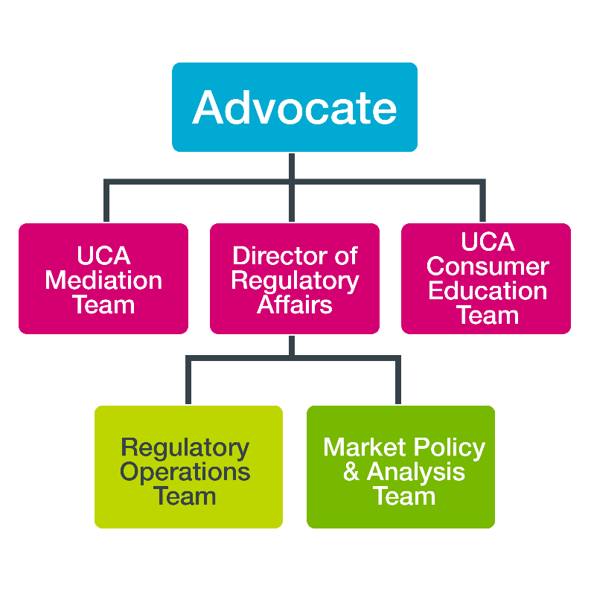
UCA Regulatory Affairs - Organization
Advocate oversees and integrates
Regulatory Affairs
Consumer Education
Mediation
Director of Regulatory Affairs
Leads Regulatory Affairs
Regulatory Operations
Ensures regulatory interventions are prioritized, resourced, meet deadlines, and are effective
Market Policy & Analysis
Supports Regulatory Operations with issues analysis
Recommends policy & regulatory changes that would benefit consumers

Slide 6
UCA Regulatory Affairs – Priority Initiatives
Assist regulatory decision-makers to gain a fuller understanding of issues under their consideration by:
intervening in regulatory proceedings;
conducting independent analysis of applications to regulatory agencies; and
presenting evidence and arguments on behalf of small consumers.
Pursue results oriented regulatory interventions and consumer focused input into GOA policy development on energy issues by:
prioritizing effort to issues of significance to consumers because of their financial, service quality, precedential, or other regulatory implications. (see next slide)
collaborating with other interveners
Reduce regulatory burden by identifying opportunities to address reoccurring regulatory issues and improving standardization of terms, tariffs, and conditions through generic regulatory proceedings or smart regulation*.
*Smart regulation is a way to improve regulatory process and make it more efficient.

Slide 7
Regulatory Proceedings Intervention Criteria
AUC conducts hundreds of proceedings each year.
UCA achieves intervener status in dozens of proceedings.
UCA uses several criteria when deciding whether to seek intervener status:
Application content’s potential impact on consumers
Likely cost disallowances possible (=> $ saved)
Estimated cost of intervention ($x)
Return on investment (Disallowances/Legal and Consulting Costs)
Importance of application in setting precedents for future applications

Slide 8
UCA Market Policy & Analysis Initiatives
Identify evolving technological, market, and policy factors and trends and their potential implications for consumers.
Participate in electricity and natural gas policy development.
Ensure timely UCA reporting of regulatory results, successes and future challenges, including informing the Minister of Affordability and Utilities on critical issues arising from regulatory applications.

Slide 9
UCA Regulatory Affairs – Performance Measures
Success rate on issues contested in regulatory proceedings
Cost disallowances (totals and dollars invested)
Overall
By proceeding (i.e. cost per proceeding)
By type of proceeding (general tariff applications, compliance, etc.)
By successful issues argued
Residential consumers switching to competitive retail contracts
Measures effectiveness of government policy and RoLR implementation
How well initiatives are working to encourage consumers to chose more cost-effective electricity plans

Slide 10
Summary
UCA Regulatory Affairs plays an important role in representing consumers’ interests to the AUC, so that the AUC has the information to make decisions in the public interest.
UCA Regulatory Affairs intervenes in dozens of proceedings each year, protecting consumers’ interests, and arguing for the lowest possible cost consistent with reasonable service.
UCA Regulatory Affairs is working hard to understand how emerging energy issues may impact consumers and participating in policy development to ensure consumer interests are represented.

